Slide 1

Presentation-2 | English-1

Slide 2
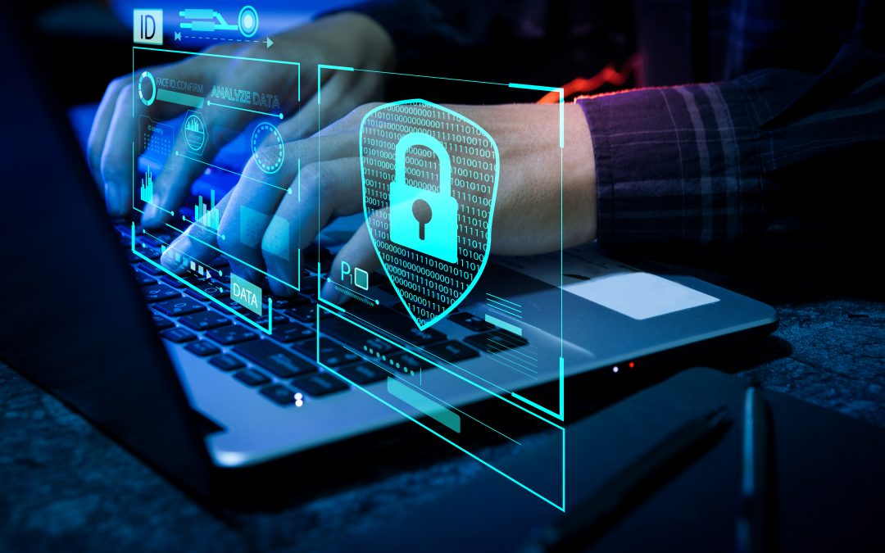
Cybersecurity: Threats, Challenges, and Solutions
This presentation explores the evolving landscape of cybersecurity, highlighting the threats, challenges, and effective solutions for safeguarding our digital world.

Slide 3

Introduction to Cybersecurity
What is Cybersecurity?
Why is it Crucial?
Cybersecurity encompasses the practices and technologies designed to protect computer systems, networks, and data from unauthorized access, use, disclosure, disruption, modification, or destruction.
In today's digital age, where data is central to personal and professional lives, cybersecurity is essential for safeguarding our privacy, finances, and critical infrastructure.

Slide 4

The Importance of Cybersecurity
in the Digital Age
Data Protection
Business Continuity
Cybersecurity protects sensitive personal and financial data from falling into the wrong hands.
It ensures that businesses can operate without interruption, avoiding costly downtime and data loss.
National Security
Cybersecurity protects critical infrastructure such as power grids, transportation networks, and government agencies from cyberattacks.

Slide 5
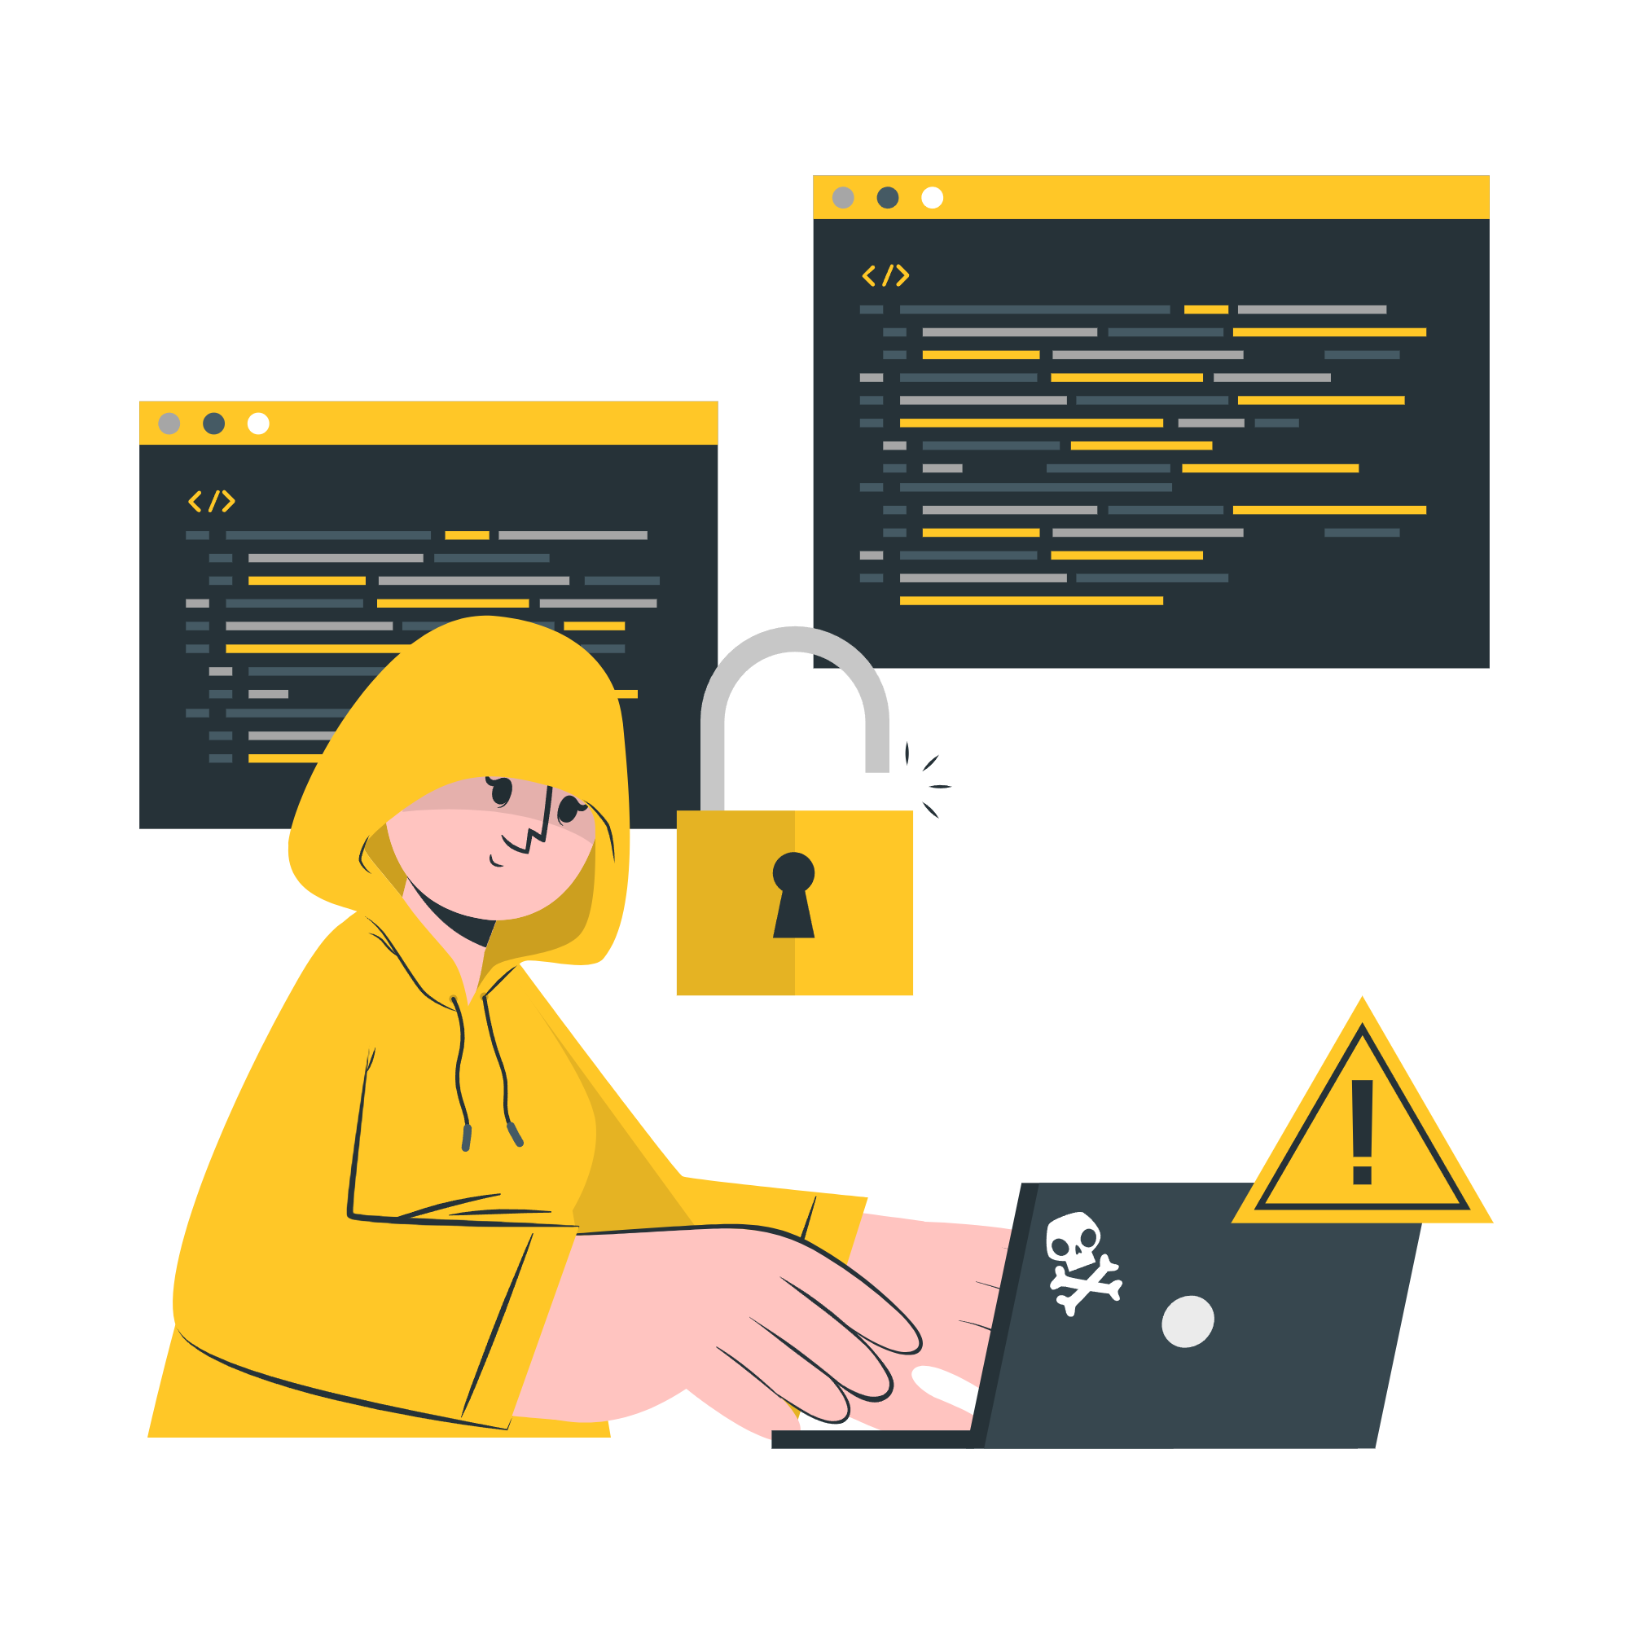
Common Cybersecurity Threats
Phishing
Malware
Deceptive emails or messages designed to trick users into revealing sensitive information.
Viruses, trojans, and ransomware are designed to infiltrate systems, steal data, or disrupt operations.
Denial-of-Service (DoS)
SQL Injection
Attacks flood systems with traffic, overwhelming them and making them unavailable to legitimate users.
A technique that exploits vulnerabilities in web applications to manipulate databases and gain unauthorized access.
Data Breaches
Unauthorized access to sensitive information, often resulting in identity theft or financial losses.

Slide 6
The Risks of Ransomware and Data Breaches
Data Encryption
1
Ransomware encrypts sensitive data, making it inaccessible unless a ransom is paid.
Data Exfiltration
2
Stolen data is often exfiltrated from compromised systems and sold on the dark web.
Financial Loss
3
Can result in financial losses like ransom payments, recovery costs, and reputational damage.
Operational Disruption
4
Businesses can experience operational disruptions, including system downtime, data loss etc.

Slide 7
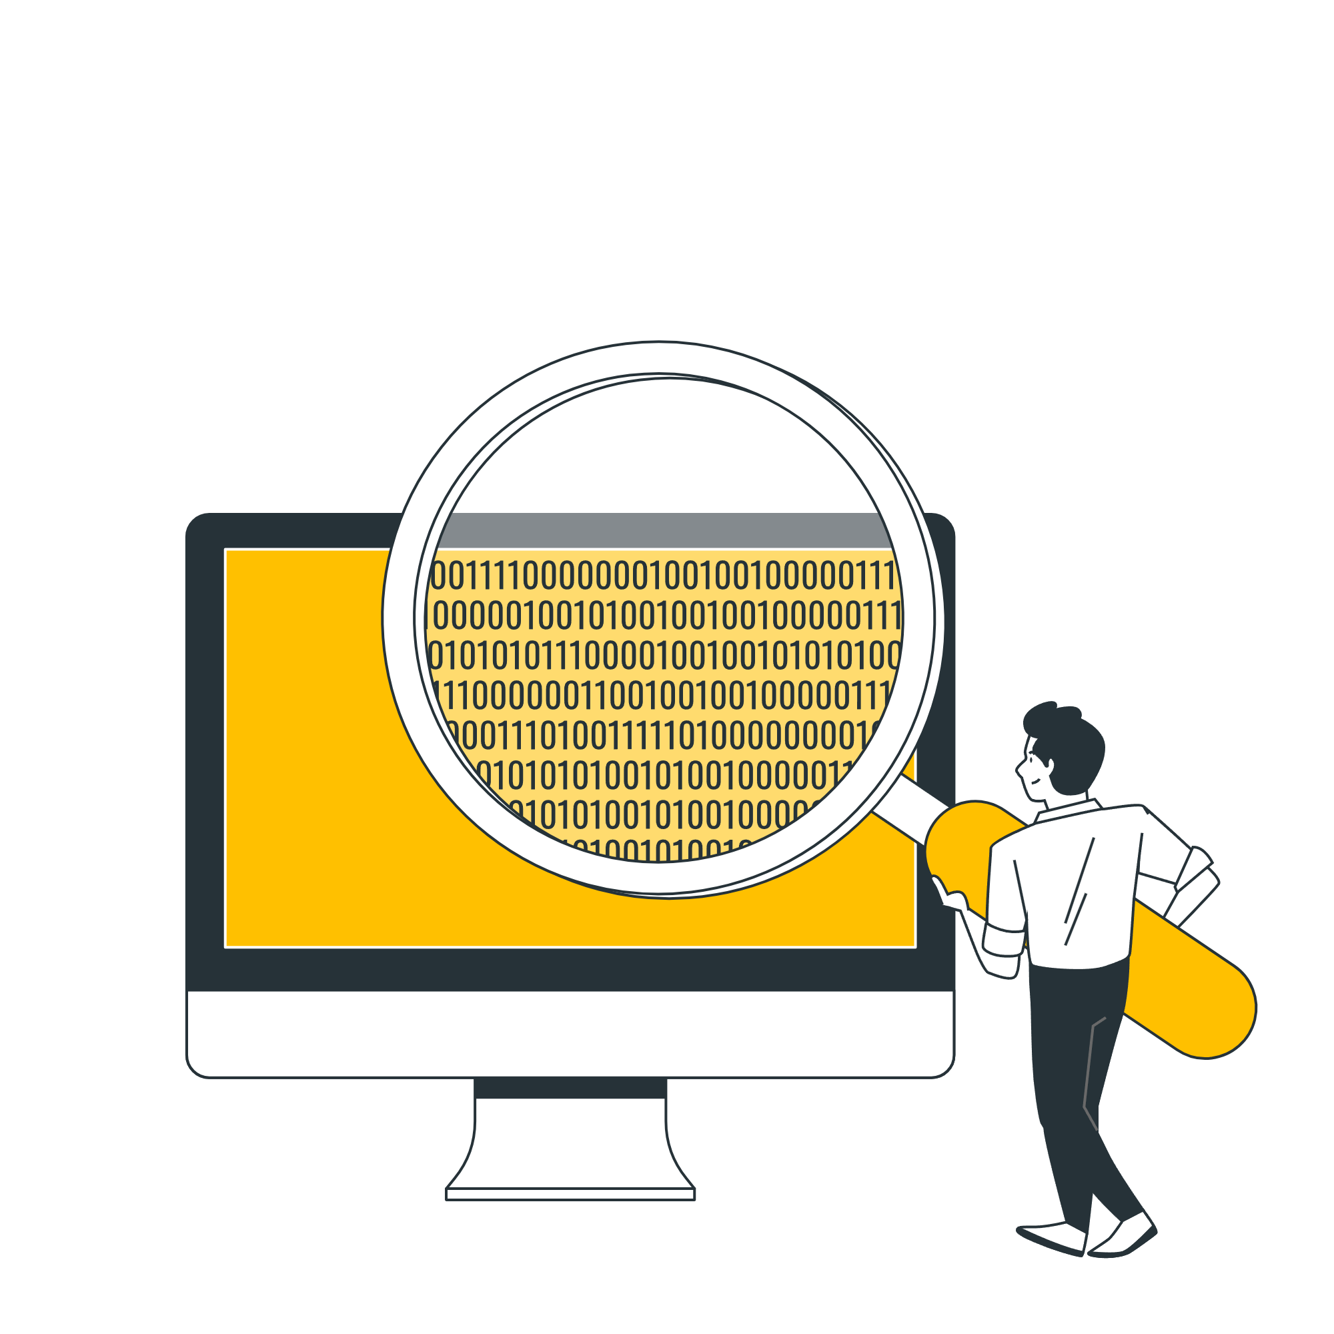
Challenges in Ensuring Cybersecurity
Emerging technologies and evolving threats require constant adaptation.
1
Lack of awareness among users creates vulnerabilities for attackers.
2
3
Resource constraints limit the ability of organizations to implement robust security measures.

Slide 8
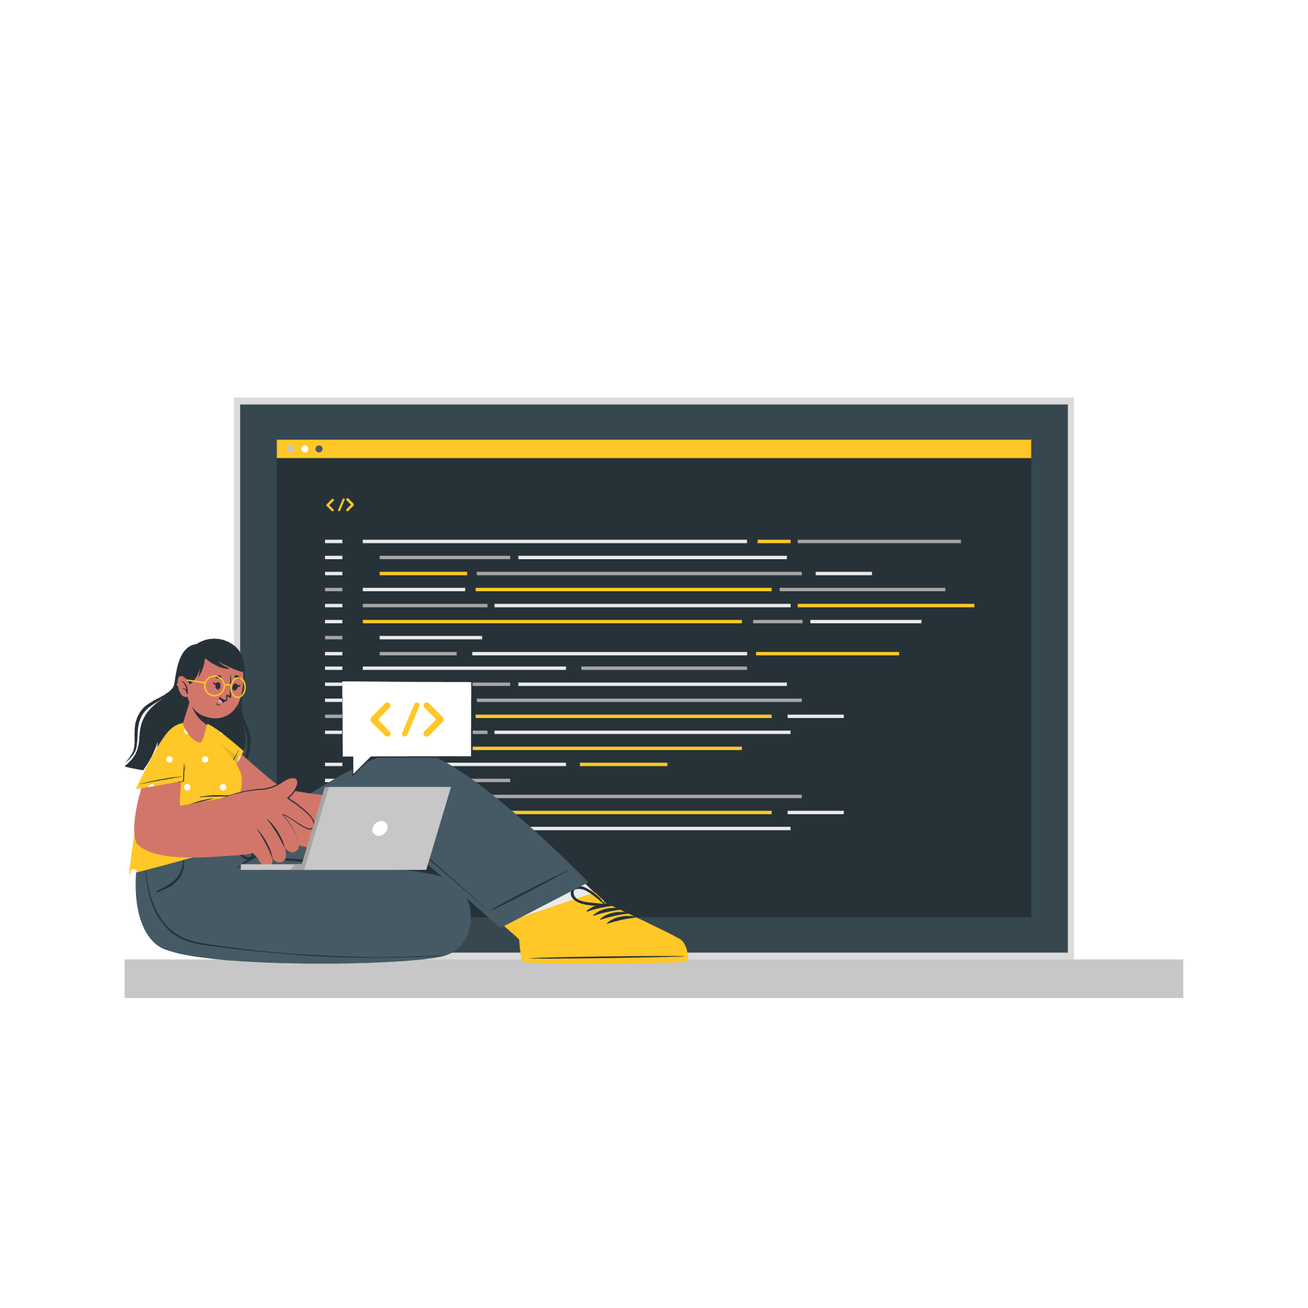



Emerging Technologies and Evolving Threats
Artificial Intelligence (AI)
AI can be used by attackers to create more sophisticated and targeted attacks.
Internet of Things (IoT)
The increasing number of connected devices creates new vulnerabilities for cyberattacks.
Cloud Computing
Data stored in the cloud presents unique challenges for security and privacy.

Slide 9
Effective Solutions and Best Practices
1
Multi-Factor Authentication
Adds an extra layer of security by requiring multiple forms of authentication.
2
Strong Passwords
Use complex and unique passwords for each account.
Regular Security Updates
3
Ensure all software and operating systems are up to date with the latest security patches.
Employee Training
4
Educate employees about cybersecurity risks and best practices.

Slide 10
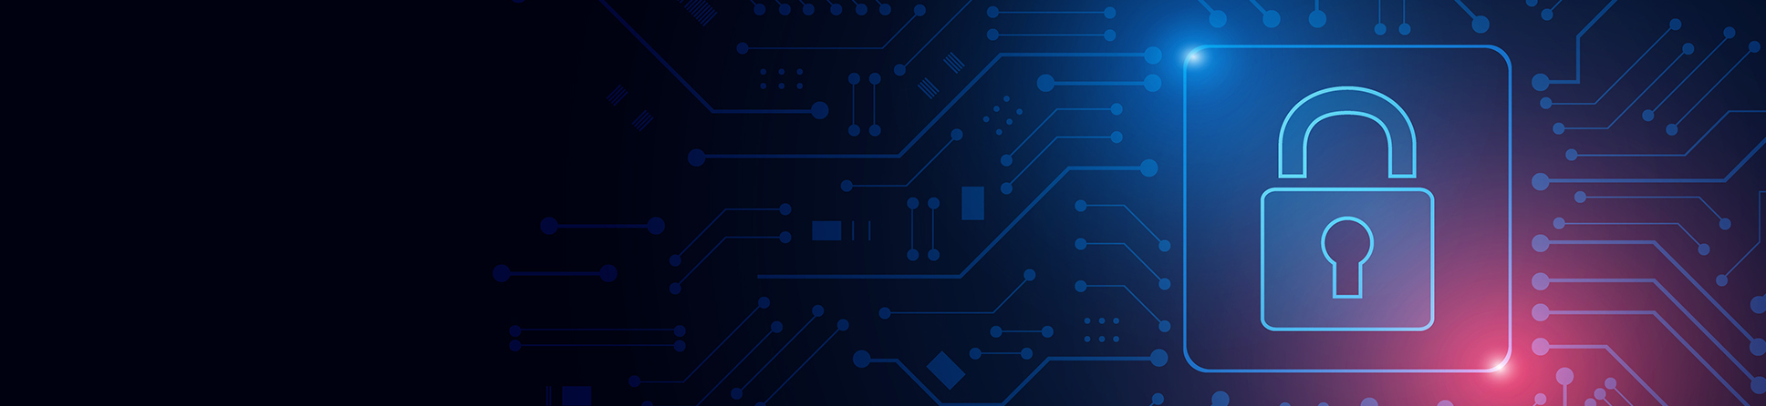




Cybersecurity Tools and Policies
Firewalls
Antivirus Software
Protect networks by blocking unauthorized access.
Detects and removes malware from computers.
Data Encryption
Incident Response Plans
Scrambles data, making it unreadable to unauthorized individuals.
Outline procedures for handling cybersecurity incidents.

Slide 11

Future Trends in Cybersecurity
Role of AI in Cybersecurity
AI-powered Threat Detection
Uses machine learning to identify anomalies in real time.
Helps detect unknown threats with pattern recognition.
Predictive Analytics
Analyzes past attack trends to anticipate future vulnerabilities.
Offers preemptive measures to prevent breaches.
Automated Incident Response
Reduces human intervention in repetitive tasks.
Ensures faster containment and mitigation of attacks.

Slide 12

Future Trends in Cybersecurity
Evolving Threats
Advanced persistent threats leveraging AI.
Quantum computing challenges to encryption methods.
Growing sophistication of phishing and ransomware.
Proactive Measures
Adopting Zero Trust Architecture for better access control.
Investing in quantum-resistant cryptography.
Fostering international collaboration for threat intelligence.

Slide 13


